Slide 1

Telling Stories with Data
Interactive Data Visualizations with D3.js
Dustin Ewers
Twitter: @DustinJEwers
Website: http://dustinewers.com
LinkedIn: www.linkedin.com/in/dustinewers/
Code Examples:
https://github.com/DustinEwers/D3-js-Demos
Blog Post:
http://dustinewers.com/d3-talk/

Slide 2
Roadmap
Why Data Visualization?
What is D3.js?
Why (and Why Not) D3.js?
How do I use D3.js? (Demos)
Notes:
Goal: To show you how to add data visualizations to .net applications.
Why?
What?
How?

Slide 3
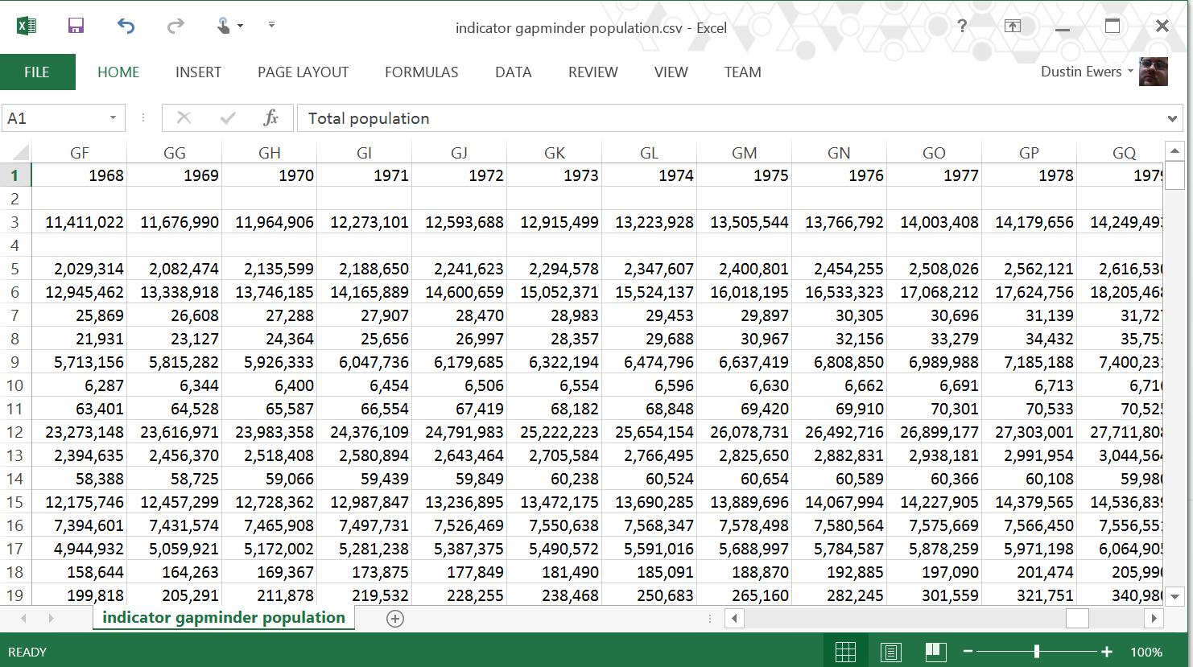
Why Data Visualization?
Notes:
Why not just use Excel?
…or stats?
…numbers?
- Numbers are more precise
- Numbers are less prone to manipulation
Data viz gives you three things:
Understanding
– Data viz adds meaning
- Data viz can tell stories
Persuasion
- People respond persuasively to two things: stories and images. Data viz gives you both.
Efficiency
There’s more data than ever before and the trend is only going up. Data viz makes it easier to understand.

Slide 4
What is D3.js
JavaScript Data Visualization Library
Invented in 2011 by Mike Bostock
Available from GitHub, Nuget, Bower, NPM, etc…

Slide 5
Why D3.js
Uses standard web technologies like JavaScript, HTML, CSS, and SVG
No plugins required
Free and Open Source (Free as in speech and beer)
D3.js includes tools to create almost any standard data visualization
Examples

Slide 6
Why Not D3.js
Can be hard to learn, especially if you are not comfortable with JavaScript.
Doesn't include any "pre-canned" visuals
Doesn't support IE8
Doesn't hide your root data.
Examples

Slide 7
D3.js Examples
https://github.com/mbostock/d3/wiki/Gallery
http://www.nytimes.com/interactive/2012/02/13/us/politics/2013-budget-proposal-graphic.html?_r=0
http://www.nytimes.com/interactive/2013/05/25/sunday-review/corporate-taxes.html

Slide 8
Demo Time!
Notes:
Demo

Slide 9
Resources
http://d3js.org/
http://bost.ocks.org/mike/
Interactive Data Visualization for the Web
http://alignedleft.com/tutorials/d3/

